Slide 1




Pausing & Resuming Fabric Capacities

Slide 2

Kane Snyder
Business Intelligence Lead @ Agile Insights
5+ Years focussed purely on Power BI
Background in business: sales and management
Love pushing the boundaries in Power BI
Presentations in user groups, live streams and featured blog posts
LinkedIn
Blog
X
Bluesky
Agile Insights

Slide 3
Pausing & Resuming Fabric PAYG Capacities
Power BI developer focussed session
Simple solutions we can all create
Lower F SKUs a game changer for smaller businesses
Solutions can add Fabric capabilities for robust ETL at low cost
Solve common issues
API connections
Manage Type 2 SCD and Snapshot Fact Tables
Manage heavy transformation requirements
Solve refresh issues

Slide 4

There’s an API to Pause & Resume Fabric Capacities!
Fabric Capacities - Resume - REST API (Azure Fabric) | Microsoft Learn
Fabric Capacities - Suspend - REST API (Azure Fabric) | Microsoft Learn
Blogs:
Resume & Suspend a Microsoft Fabric Capacity (oliviervs.be)
Save Money when using Microsoft Fabric with Pause and Start Capacity (mssqltips.com)
Microsoft Fabric: Capacity Cost Management Part 2, Automate Pause/Resume Capacity with Azure Logic Apps - BI Insight

Slide 5


Yay! we can run this in Pipeline in Fabric?
…….Unfortunately, you can't run a pipeline or notebooks in a capacity that is paused
We need another way to start the Fabric Capacity:
How to execute some python on a schedule?
VS Code Online
Power Automate Desktop
Cloud Services
Azure Runbooks
ADF
Another Fabric Capacity that is not paused…..

Slide 6

One simple option is an Azure logic App
But first to build this we need to do some housekeeping and setup some stuff:
Service Principal
user_impersonation granted permission for service principal
Service principal added to the fabric capacity as Contributor role
Key Vault
Add secret and credentials from service principal
Register a Microsoft Entra app and create a service principal - Microsoft identity platform | Microsoft Learn

Slide 7
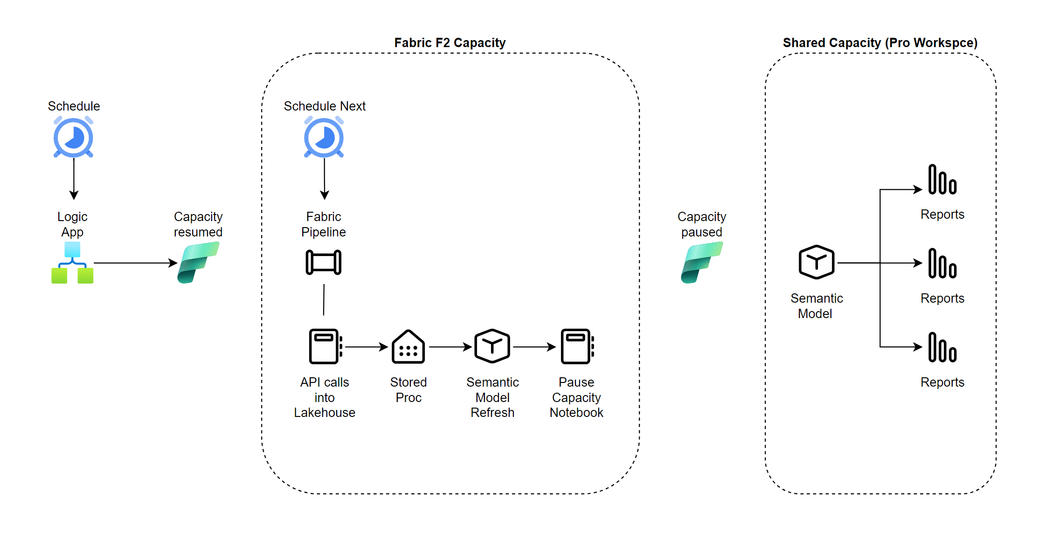
Solution Overview

Slide 8

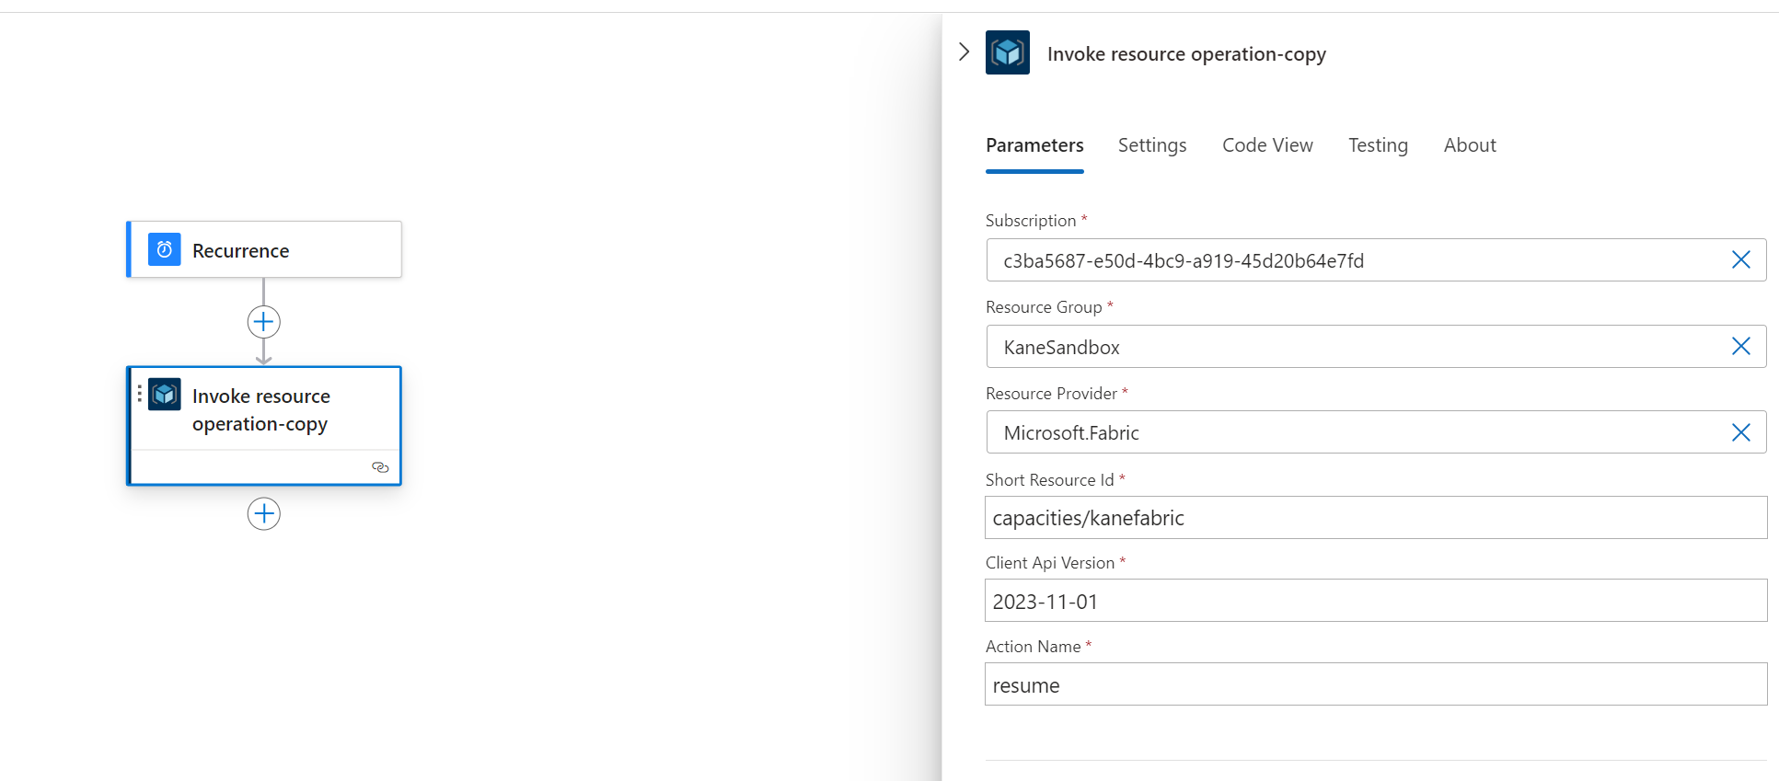
Starting / Resuming with a Logic App

Slide 9


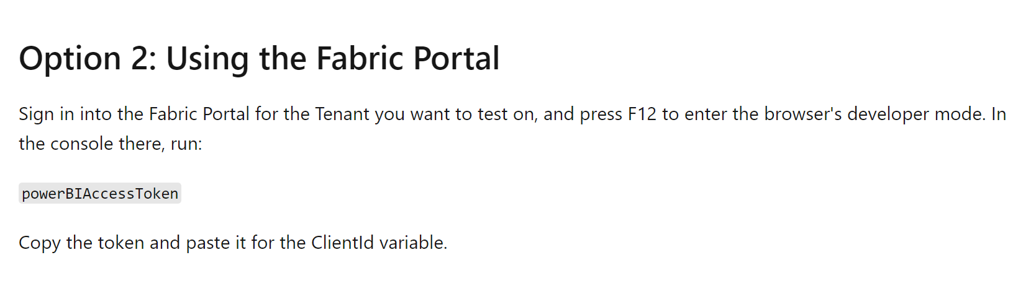
Soon we should be able to trigger the pipeline from a logic app!
Fabric data pipeline public REST API (Preview) - Microsoft Fabric | Microsoft Learn

Slide 10
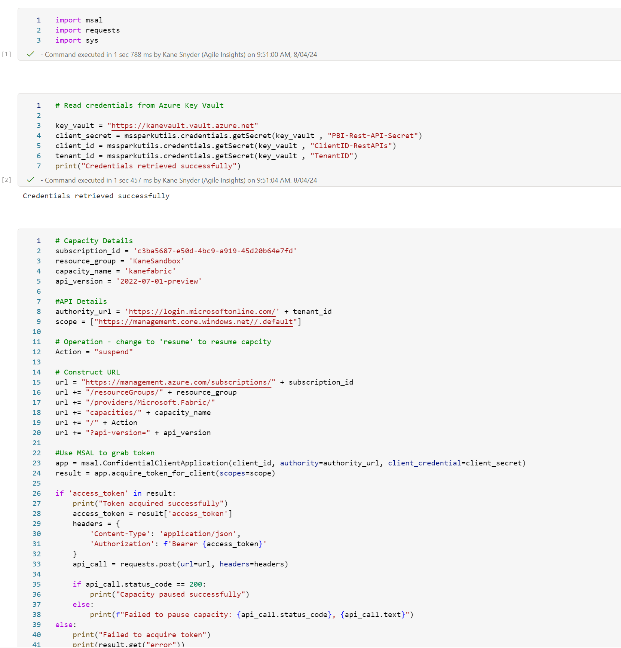

Next we can setup the pause capacity operation in Fabric Base code stolen from: Resume & Suspend a Microsoft Fabric Capacity (oliviervs.be)

Slide 11

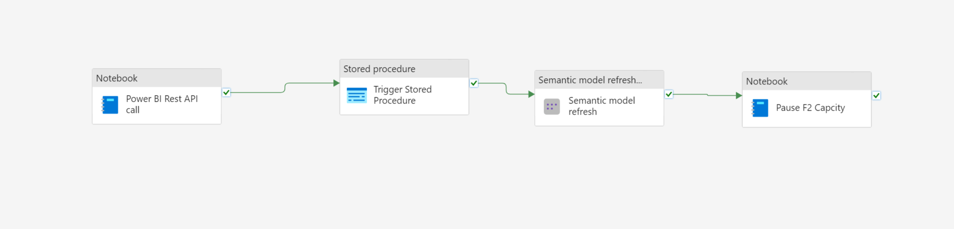
Create the pipeline
We can now create a pipeline to orchestrate our ETL operations
It’s also possible to execute the pause capacity using the pipeline only. Microsoft Fabric-Pause, Scale a Capacity Pipeline | Medium

Slide 12

Sky’s the limit!
Many options: Notebooks, Logic Apps, Pipeline Web Activities, Pipeline API
Limit to business hours
A reserved capacity gives you around a 41% discount so if you limit a PAYG capacity to even just daytime hours, you may already be winning. This depends on CU usage though.
Run a low F SKU for BAU and a larger PAYG for ETL
If you need to give users access to manually refresh import models, Direct Lake Mode or run SQL queries etc, then an F2 reserved capacity might be enough with a larger PAYG capacity enabled purely for an ETL operation.
Test the Waters
This can be good as a low cost POC or stepping stone in a journey towards a larger analytics solution.
Cost? How to calculate Microsoft Fabric costs - FourMoo | Fabric | Power BI

Slide 13

Questions

